Slide 1
Introduction to NLP
Summary
Dr. John McCrae, Dr. Paul Buitelaar
Data Science Institute, University of Galway

Slide 2
Introduction

Slide 3
Natural Language Processing
text text text ….
Decisions
NLP
more text
DATA
Knowledge

Slide 4
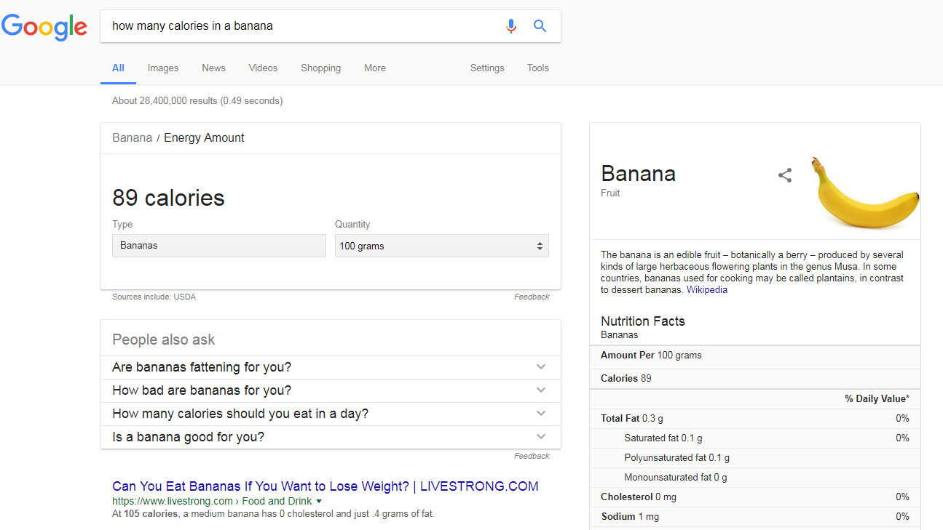
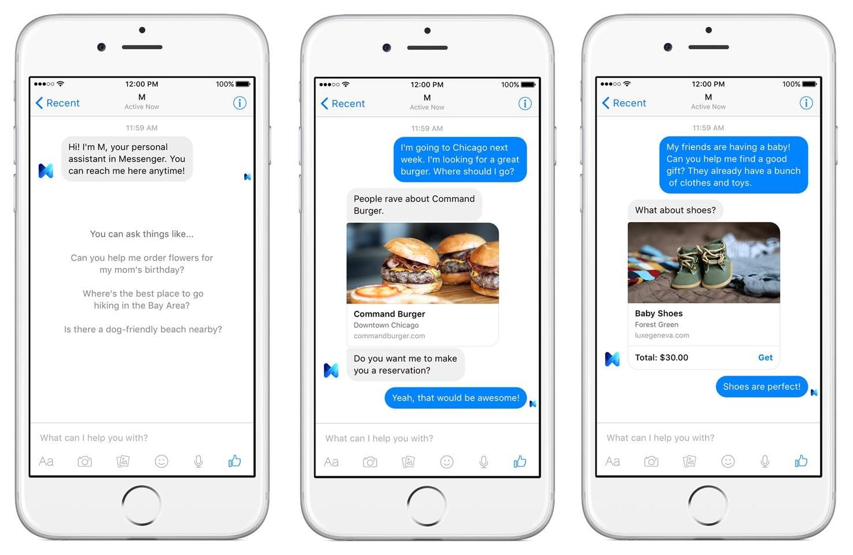
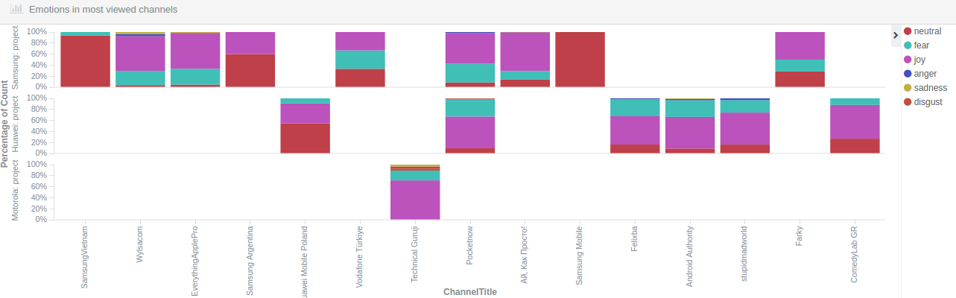
Applications
Information Retrieval
Chatbots
Sentiment Analysis

Slide 5
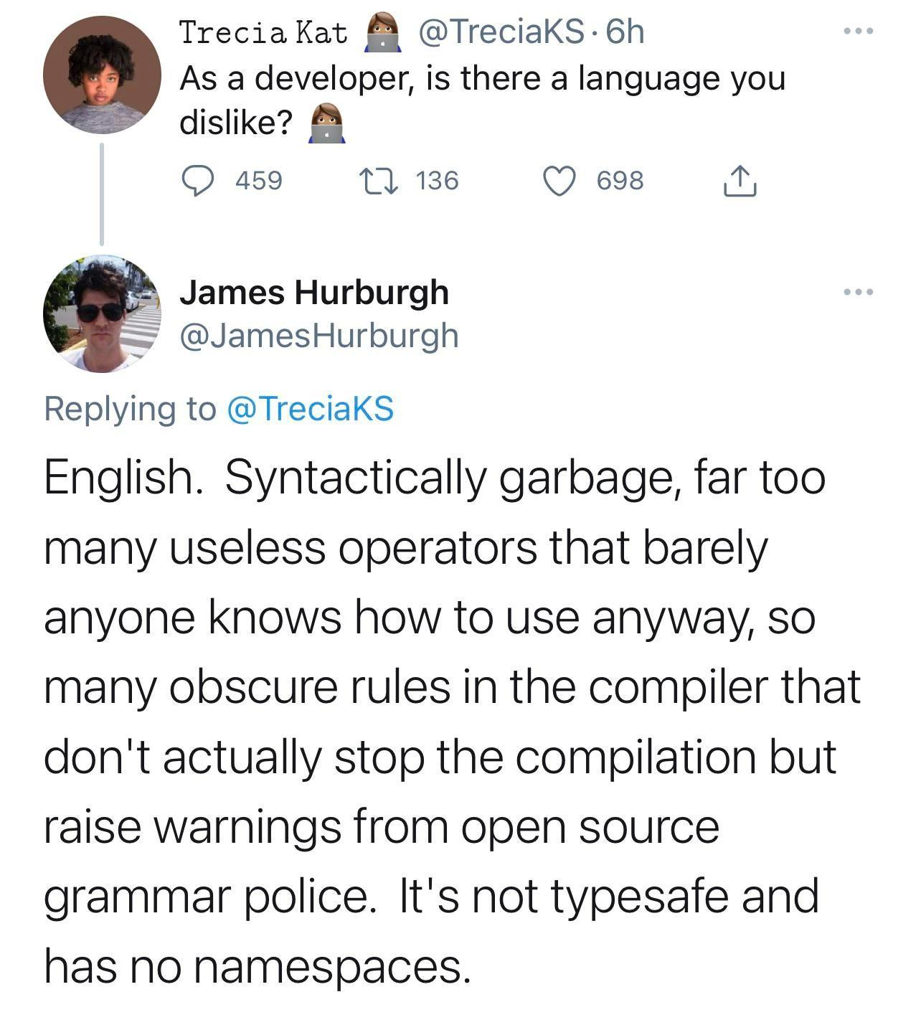

Slide 6
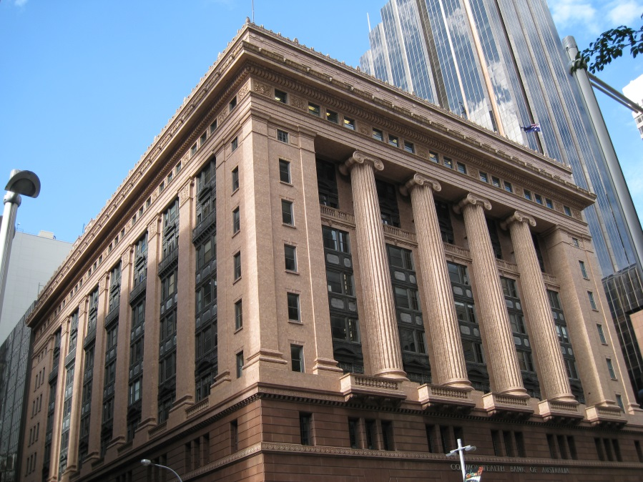
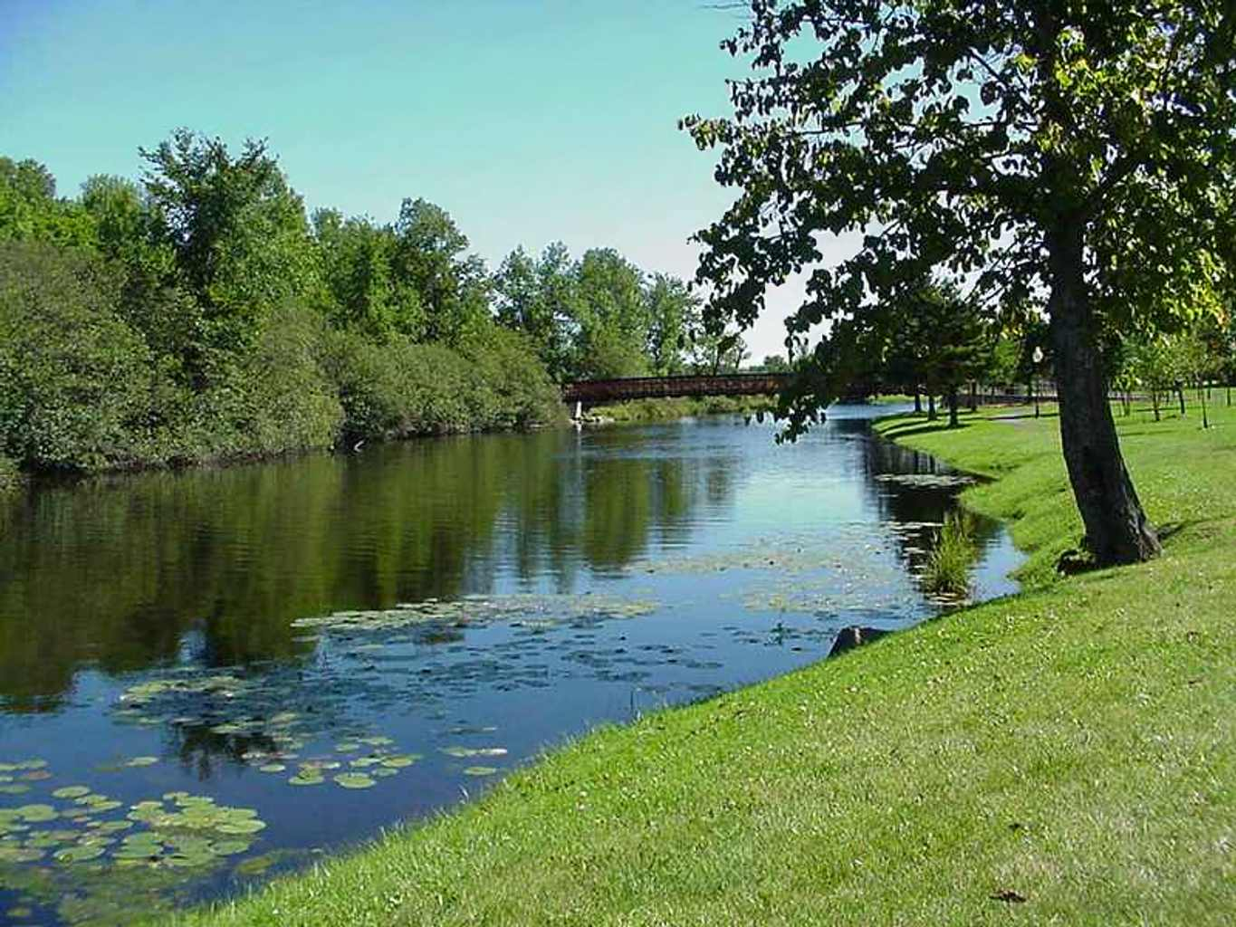
Lexical Ambiguity
savings bank vs. river bank

Slide 7
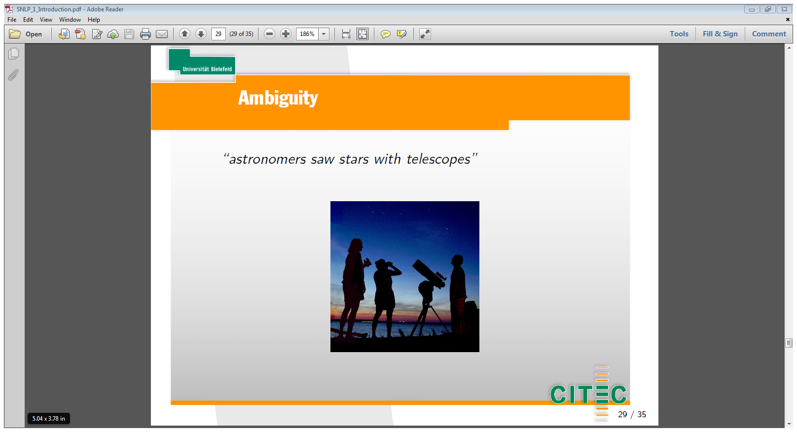
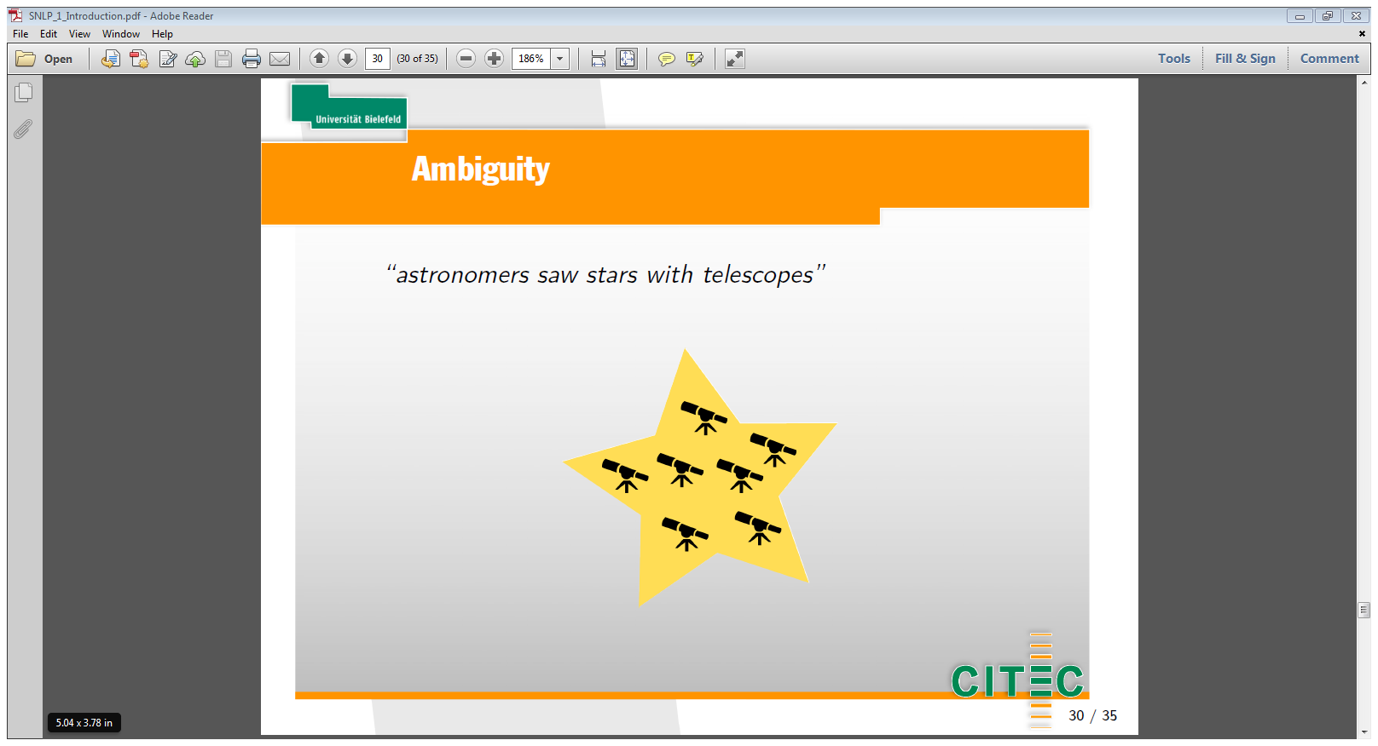
Syntactic Ambiguity
astronomers saw stars with telescopes

Slide 8
Linguistic Concepts

Slide 9
Linguistics and NLP
Linguistics
Linguistics develops a theory that explains
use of language - ‘language performance’
knowledge and acquisition of language - ‘language competence’
NLP employ this theory (among others) to utilise/model
use of language - data
knowledge and acquisition of language - models
NLP

Slide 10
Linguistic Levels of Analysis
Phonology – acoustic signal
Morphology – word structure
Syntax – sentence and phrase structure
Semantics – meaning and reference
Discourse – relations between sentences
Pragmatics – communication
sounds
structure
meaning

Slide 11
Linguistic Levels of Analysis
S
NP
VP
VP
SYNTAX
NP
PART OF SPEECH
PRP
VBP
VBG
DET
NN
NN
I am enjoying the NLP course
WORDS
person: 1st
number: singular
case: nominative
person: 1st
number: singular
tense: present
mood: indicative
tense: present
number: singular
case: proper
number: singular
MORPHOLOGY
NLP¹: [abbreviation] natural language processing
COURSE¹: a series of lessons or lectures on a particular subject
SEMANTICS

Slide 12

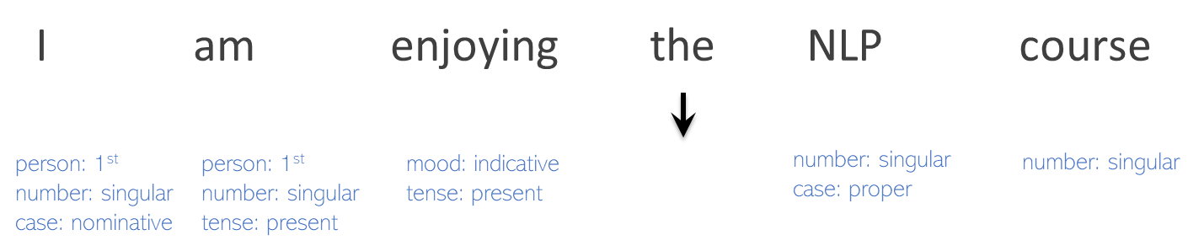
Morphology & Tokenization
Linguistics
We want to study the internal structure of words
NLP
We want to convert the text into a more convenient, standard form.
Let us look at:
Tokenization: types vs. tokens
Morphology: stemming vs. lemmatization
Morphology: inflection & derivation
Notes:
We’ll then turn to a set of tasks collectively called text normalization, in which normalization. Normalizing text means converting it to a more convenient, standard form.

Slide 13
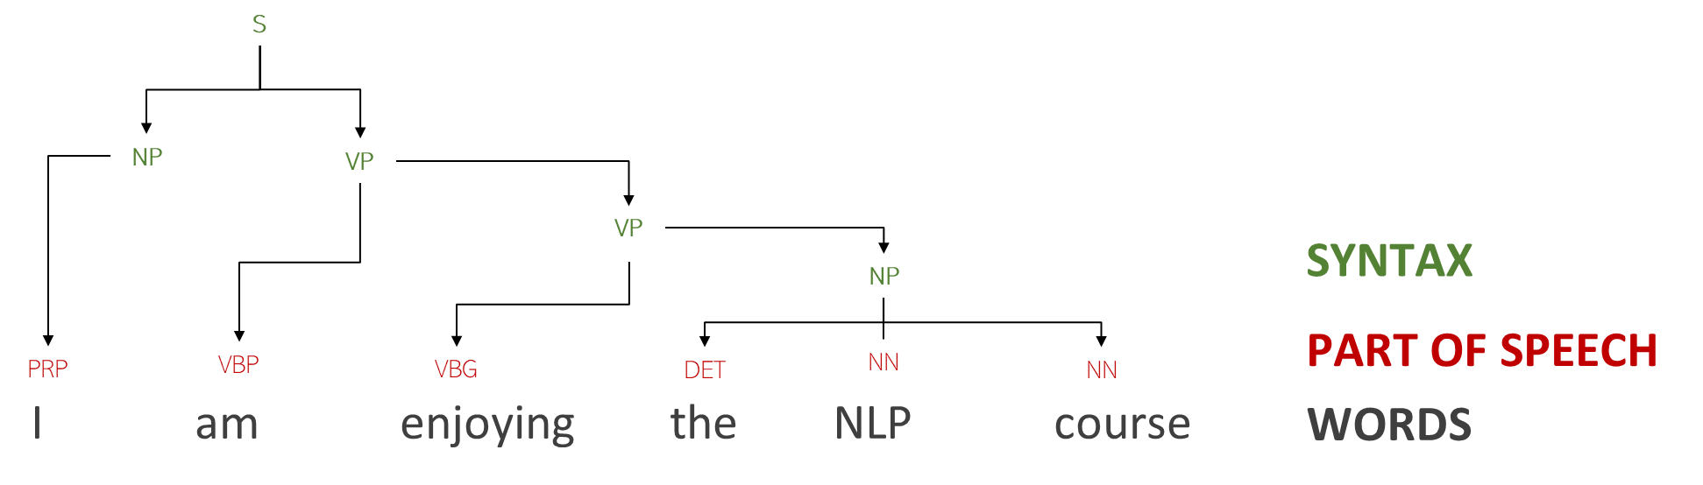
Syntax
The study of the structure of sentences/phrases and how words modify one another.
We want to understand “How sentences are formed from words” in a certain language
What can help us:
Part of Speech (PoS)
Phrase Structure
Grammatical (Dependency) Relations

Slide 14
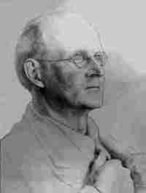
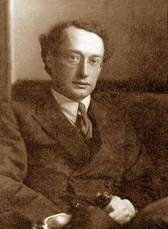
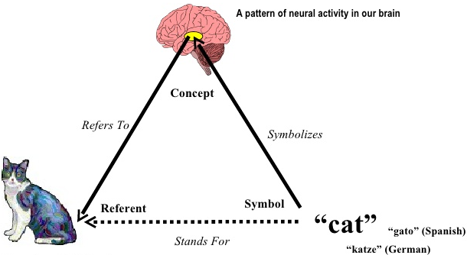
Semantics
The study of meaning (interpretation) and reference
Foundations in Semiotics: the study of signs, symbols and their reference
Semiotic Triangle is interface between:
C. K. Ogden
I. A. Richards
objects in the world (referents)
cognitive interpretation of these objects (concepts)
symbolic representations for these cognitive interpretations (linguistic symbols)
The relation between linguistic symbols and concepts is commonly referred to as ‘meaning’.
C. K. Ogden and I. A. Richards, The Meaning of Meaning: A Study of the Influence of Language upon Thought and of the Science of Symbolism (1923)

Slide 15






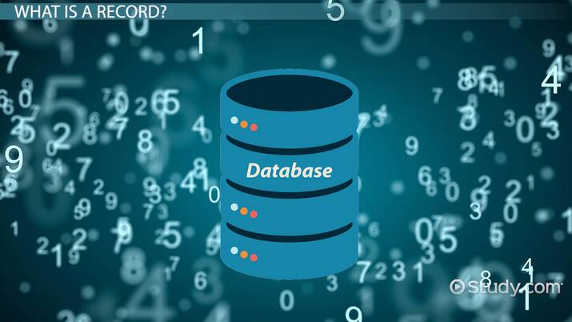
Language Data – Types
Images courtesy: https://media.gcflearnfree.org/content/59568c218444e80fc02ecc5d_06_30_2017/businessreport_illustration.jpg
https://cdn.relevance.com/wp-content/uploads/2020/04/Social-Media-Marketing-Software.jpg
https://www.engagebay.com/blog/wp-content/uploads/2019/07/html-or-plain-text-emails.png ; https://media.istockphoto.com/videos/newspaper-headline-breaking-news-video-id187763065?s=640x640
https://study.com/cimages/videopreview/videopreview-full/dl4oegfq0k.jpg ; https://www.thestatesman.com/wp-content/uploads/2021/01/iStock-458651827.jpg

Slide 16
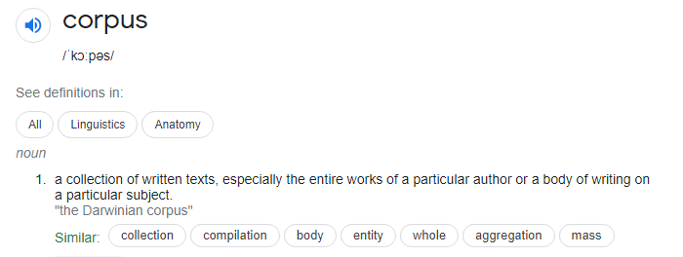
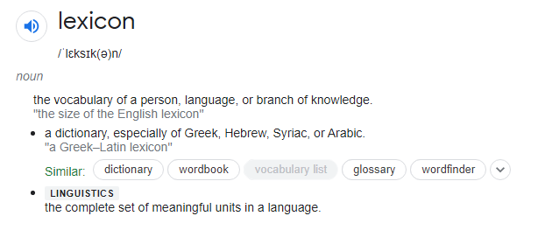


Language Data
Corpus: Collection of texts
Lexicon: Collection of words (vocabulary)
Annotated corpus vs. ‘raw data’
General vs. Domain-specific corpus
Monolingual vs. Multilingual corpus
Parallel vs. Comparable multilingual corpus
Multimodal corpus

Slide 17
Text Classification

Slide 18
Subject Classification
Is this article about:
In ancient Egypt, cats were worshipped, and the goddess Bastet often depicted in cat form,
Cats?
NLP
Religion?
Art?

Slide 19
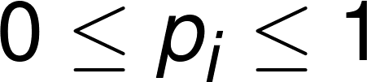
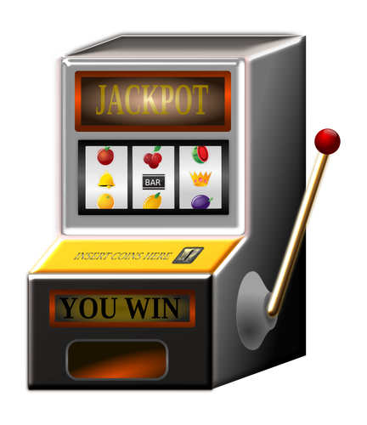
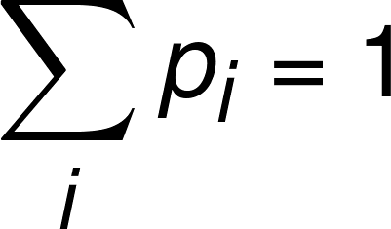
Probability in NLP
The most likely answer is “雪豆”
If the rules are ‘incomplete’ then we should produce the most likely answer

Slide 20
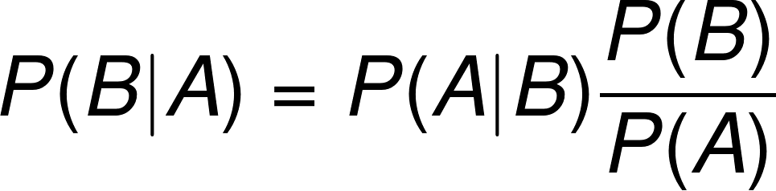
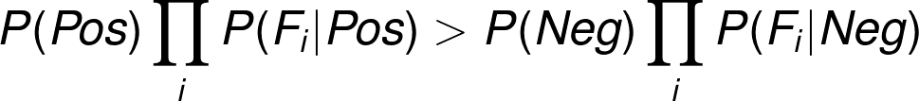
Bayes’ Law
Notes:
P(A\cap B) = P(A|B)P(B) = P(B|A)P(B)
1 = \frac{P(A \cap B)}{P(B \cap A)} = \frac{P(A|B)P(B)}{P(B|A)P(A)}

Slide 21
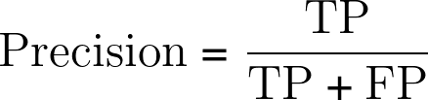
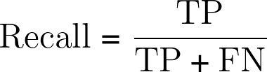
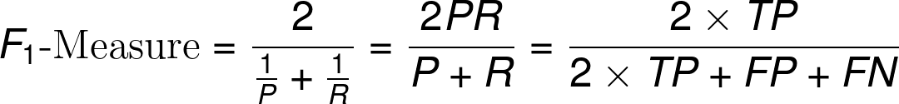
Precision, Recall
True Positive
False Negative
 | Positive Test | Negative Test
Zombie | 9 | 1
Citizen | 9 | 81
False Positive
True Negative

Slide 22
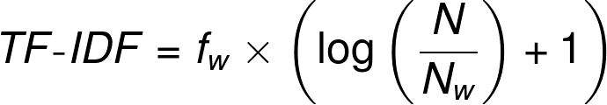
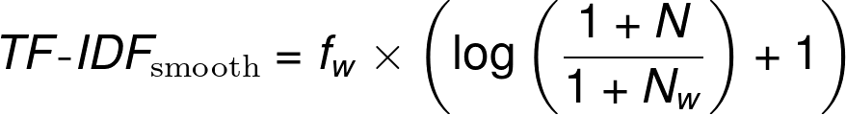
TF-IDF
This is often combined into a single score
TF-IDF = Term Frequency Inverse Document Frequency
Occurrences of w in current document
Notes:
TF\text{-}IDF=f_w \times \left( \log\left\(\frac{N}{N_w}\right) + 1\right)

Slide 23
Sequence Models

Slide 24


Language Modelling
Band
ribbon
band
volume
“I will be there in five minuts”
Most likely solution is useful for many tasks such as spelling correction or machine translation
minuets
minutes

Slide 25
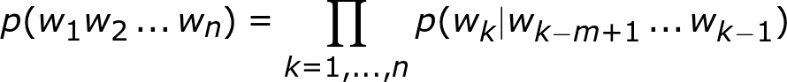
N-gram approximation
Estimate of the probability of a sequence of words can be efficiently acquired using a n-gram model
Look back only m - 1 words

Slide 26
Hidden Markov Model
p(w₁,w₂,w₃,t₁,t₂,t₃) ≈
p(w₃|t₃) ×
p(t₃|t₂) ×
p(w₂|t₂) ×
p(t₂|t₁) ×
p(w₁|t₁) ×
p(t₁)
p(t₁|t₀)
p(t₂|t₁)
p(t₃|t₂)
t₀
t₁
t₂
t₃
p(w₁|t₁)
p(w₂|t₂)
p(w₃|t₃)
w₁
w₂
w₃

Slide 27
Error Detection
IOB
We can use tagging to find spelling/grammar errors
OK
Misspelled
OK
Ungrammatical
Is thsi really correctly?

Slide 28
Sequence Generation
We can also generate text… use the next word as the tag!
We then repeatedly generate the next word based on the prediction.
Kong
where
Evergrande
has
its
main
listing
</s>
Hong Kong where Evergrande has its main listing

Slide 29
Parsing

Slide 30
Constituency Parsing
The girl, who is playing with cars, likes toast
POS Tagging
DT NN WP VBZ VBG IN NNP VBZ NN
NP
NP
S
VP
VP

Slide 31
Dependency parsing
The girl, who is playing with cars, likes toast
aux
det
nsubj
prep
pobj
dobj
relcl
nsubj

Slide 32
Context-free grammars
Recall, a context-free grammar G=(N,Σ,P,S) consists of:
A set of non-terminal symbols N
e.g., 'N', 'VP', 'S'
A set of terminal symbols Σ
e.g., 'cat', 'astronomer', 'the'
A set of productions P
e.g., 'S → NP VP'
A start symbol
Normally 'S'

Slide 33
CYK Algorithm
def cyk_parse(text):
# make a tableau
tableau = CYKTableau(len(text))
# spans of length 1 to len(text) (inclusive)
for span in range(1,len(text) + 1):
# i is the index of the start of the span
for i in range(len(text) - span + 1):
# k is the index of the end of the span
k = i + span
if span == 1:
for rule in find_preterminal_rule(text[i]):
tableau.update_prob(i, k, rule.lhs, rule.prob)
else:
# j is the split in the rule
for j in range(i + 1, k):
# search for matching rules
for tag1 in tableau.get_tags(i, j):
for tag2 in tableau.get_tags(j, k):
for rule in find_rules(tag1, tag2):
# Calculate updated probability
p = (tableau.get_prob(i, j, tag1) *
tableau.get_prob(j, k, tag2) *
rule.prob)
tableau.update_prob(i, k, rule.lhs, p)

Slide 34
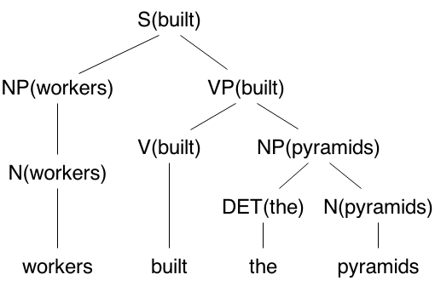
Challenges and Solutions with Parsing
Issues with PCFGs:
Lexical Dependencies
Lexical Attachment (‘he hit the man with a bat’)
Parse ambiguity
Solutions
Lexicalised parsing
Dependency parsing

Slide 35
Vector Space Models

Slide 36
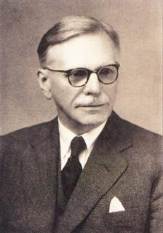
Distributional Hypothesis
“you shall know a word by the company it keeps” - (Firth 1957)
cat and dog occur in similar contexts, therefore similar in meaning
Distributional Semantics
Firth, J.R. (1957). "A synopsis of linguistic theory 1930-1955". Studies in Linguistic Analysis: 1–32

Slide 37
Co-occurrence Matrix (Context N=1)
Corpus
The cat lies on the mat.
The dog lies on the floor.
The cat sits near the door.
The dog lies near the door
Targets
cat, dog
Vocabulary of context words (V)
the, lies, on, mat, floor, sits, near, door
V | the | lies | on | mat | floor | sits | near | door
cat | 2 | 1 | 0 | 0 | 0 | 1 | 0 | 0
dog | 2 | 2 | 0 | 0 | 0 | 0 | 0 | 0

Slide 38
Vector Space for cat, dog with 3 Dimensions
sits
V | the | lies | on | mat | floor | sits | near | door
cat | 2 | 1 | 0 | 0 | 0 | 1 | 0 | 0
dog | 2 | 2 | 0 | 0 | 0 | 0 | 0 | 0
cat
the
lies
dog

Slide 39
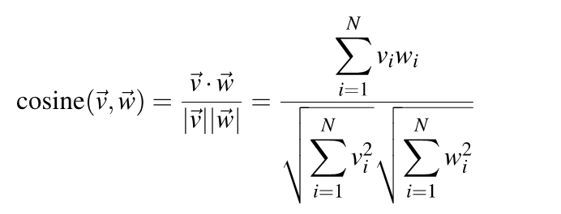
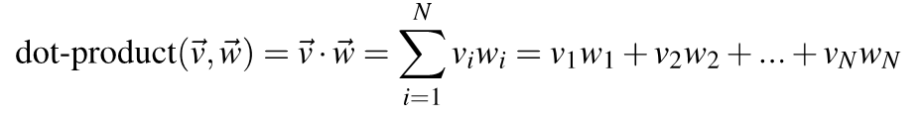
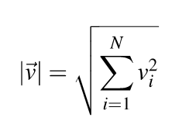
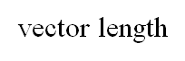
Cosine Similarity
v_{i} w_{i} is the count for word v,w in context i

Slide 40
Context
Context window
document, sentence, phrase, word sequence
Context content
stopwords, specific part-of-speech, syntactic dependencies, etc.
Context weights
measure of co-occurrence strength between target and context words

Slide 41
Context Weight - PMI
Pointwise Mutual Information (PMI)
PMI is a correlation or association measure that quantifies the likelihood of co-occurrence of two events. In distributional semantics we use PMI to measure the likelihood of co-occurrence of two words across a corpus:
PMI (w₁ , w₂) = log ( P(w₁ , w₂) / P(w₁) * P(w₂))
P(w₁) P(w₂) = probability (relative frequency) of w₁ w₂ occurring in C
= frequency of w₁ w₂ occurring in C / all words W in C
P(w₁ , w₂) = probability of w₁ co-occurring with w₂ in corpus C

Slide 42
Word Embeddings
Generalization
Capture similarity on the level of word vectors rather than words
Prediction
Predict words and their contexts by use of language modeling
Dimensionality reduction
Optimize sparse vectors (with lots of zeros) into shorter dense vectors

Slide 43
Recurrent Neural Networks

Slide 44
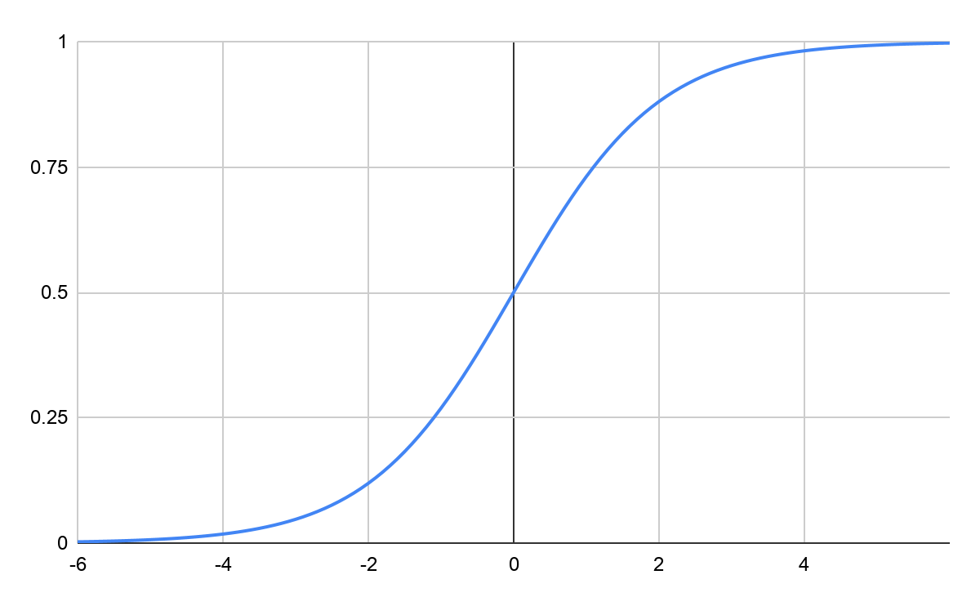
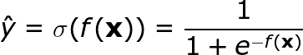
Log-linear modelling
f(x) as introduced outputs in range [-∞, ∞]
Instead we could use a function that outputs in [0, 1]
We can now say how certain we are of
a prediction
Notes:
\hat{y} = \sigma(f(\mathbf{x})) = \frac{1}{1 + e^{-f(\mathbf{x})}}

Slide 45
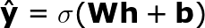
Multiple Layers
y₁
σ
σ
Note we now have the following parameters:
Θ = { W, V, b, c }
We can learn the model the same way.
σ
σ
σ
…
x₁
x₂
x_{n}

Slide 46
Recurrent Neural Networks
Output layer is input of next cell
Parameters A and b are shared between each layer
A,b
Unroll
A,b
A,b
A,b

Slide 47
Loss
Predicting RNNs
Output
Output
Output
Loss
y₁
y₂
y₃
Output Layer
h₁
h₂
h₃
discarded
discarded
x₁
x₂
x₃
h₁
h₂
h₃
Tagging RNNs
x₁
x₂
x₃

Slide 48
y₁
y₂
Stacked RNNs
h₁
h’₁
h’’₁
h₂
h’₂
h’’₂
x₁
x₂
Shared Parameters
y₁
y₂
y₃
h₁
h₂
h₃
h’₁
h’₂
h’₃
Bidirectional RNNs
x₁
x₂
x₃
Notes:
\mathbf{h}'_i = f(\mathbf{U}'\mathbf{h}'_{i+1} + \mathbf{W}'\mathbf{x}_i + \mathbf{v}')

Slide 49
this
is
a
Generator/Language Model RNNs
h₁
h₂
h₃
</s>
this
is

Slide 50
Gates/LSTMs
Long Short-Term Memory solves the problem of vanishing gradient
Combines a long-term and a short-term path by means of gates
Gate Vector
0.5
0.3
0.7
0.2
0.8
0.5
0.3
0.9
0.1
0.8
1.0
0.1
0.2
0.3
0.45
0.03
0.56
0.20
0.08
0.10
0.09
Hidden Layer Vector
Focus Vector
Another Neural Network

Slide 51
Transformers and Deep NLP

Slide 52
Attention
Attention
Distribution
y₁
y₂
y₃
y₄
y₅
y₆
h₁
h₂
h₃
h₄
h₅
h₆
the
food
was
not
so
great
Not Important
Important words

Slide 53
Embed, encode, attend, predict
Embedding
RNN
Multilayer Perceptron
Embedding
RNN
Prediction
Embedding
RNN
Fully-Connected
Softmax
Fully-Connected
Fully-Connected

Slide 54
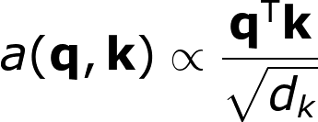
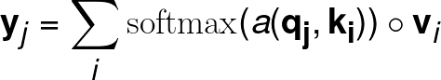
Self-attention
Attention is so powerful, it is all you need! (No RNNs)
Predict three vectors, q, k, v
q₁
q₂
q₃
k₁
k₂
k₃
v₁
v₂
v₃
x₁
x₂
x₃
Linear transform:
q_{i} = A_{q}x_{i} + b_{q}
k_{i} = A_{k}x_{i} + b_{k}
v_{i} = A_{v}x_{i} + b_{v}

Slide 55
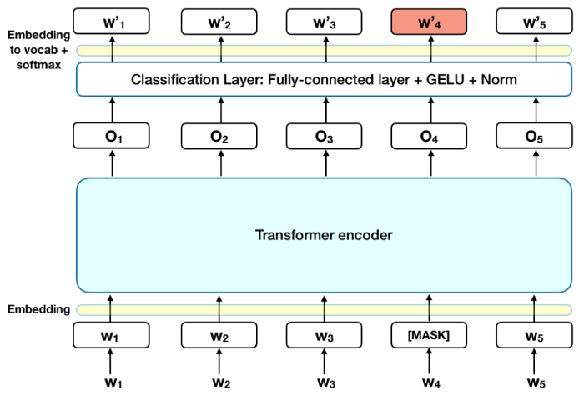
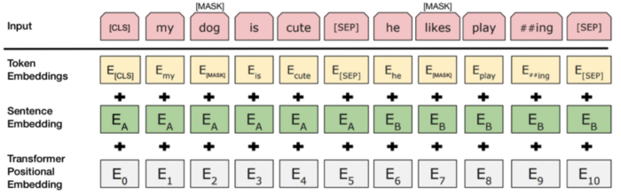
BERT
Masked Language Model
Next Sentence Prediction
Image source: https://towardsdatascience.com/bert-explained-state-of-the-art-language-model-for-nlp-f8b21a9b6270

Slide 56
Word Embedding Applications
Similarity (Word vs. document, cosine
Analogy: w_{x} ≃ w_{king} - w_{man} + w_{woman}
analogy(m, w → k) = argmax [ cos(v,k) - cos(v,m) + cos(v,w) ] (3CosAdd)
Projection

Slide 57
Arc-factored parsing
The/DET
big/JJ
dog/NN
chased/VBP
the/DET
cat/NN
Word Embedding (big)
Word Embedding (the)
POS Embedding (JJ)
POS Embedding (DET)
Distance
Prediction Model
ArcScore(big/JJ,the/DET)

Slide 58
Extractive versus abstractive
Galway is a city in West of Ireland and is the sixth most populous city on the island of Ireland.
Galway (/ˈɡɔːlweɪ/ GAWL-way; Irish: Gaillimh, pronounced [ˈɡal̠ʲɪvʲ]) is a city in the West of Ireland, in the province of Connacht. It is the county town of County Galway, which is named after it. It lies on the River Corrib between Lough Corrib and Galway Bay, and is the sixth most populous city on the island of Ireland and the fourth most populous in the Republic of Ireland, with a population at the 2016 Census of 79,934.
Extractive Summarization
Galway is a city in Ireland on the River Corrib.
Abstractive Summarization
Embedding

Slide 59
Semantic Analysis

Slide 60

Word Sense Disambiguation (WSD)
“Do you mean an overview of your interest in this company?”
Question Answering and Chatbots
“Do you mean the interest on your account”
“What is my interest here?”
Images source https://towardsdatascience.com/automatic-question-answering-ac7593432842

Slide 61

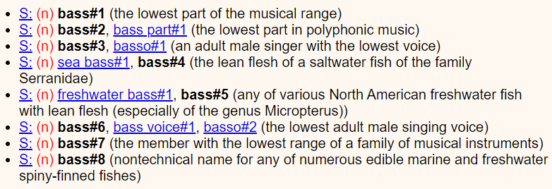
WSD Task
disambiguated (correct) word sense
a word in context
An electric guitar and bass player stand off to one side
An electric guitar and bass^{7 INSTRUMENT} player stand off to one side
WSD Algorithm
fixed inventory of word senses

Slide 62

Approaches to WSD
Unsupervised
Knowledge-based
Graph-based
Supervised
Word Sense Annotated Corpora
Semi-supervised
Distant supervision
Image source: https://www.coursera.org/learn/machine-learning

Slide 63
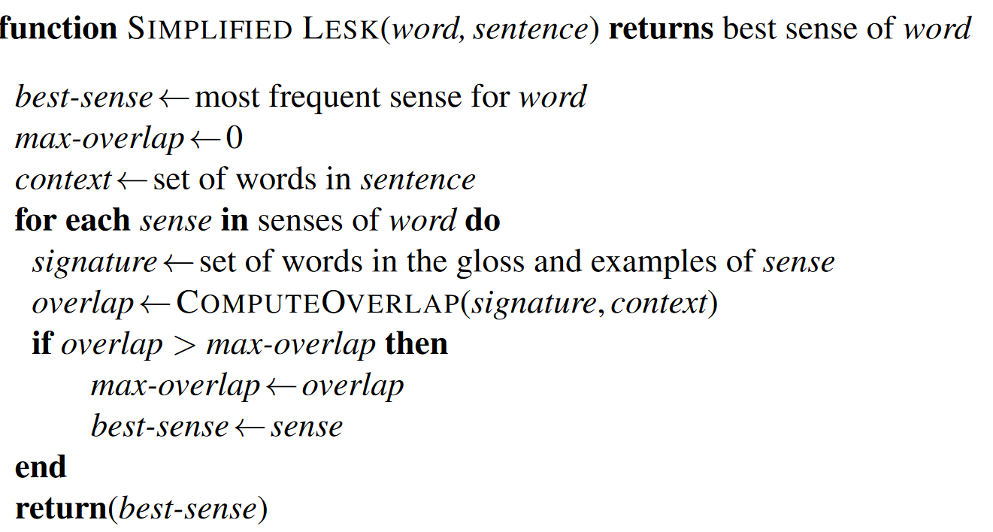
(Simplified) Lesk Algorithm
Jurafsky & Martin, 3rd ed., p.367

Slide 64
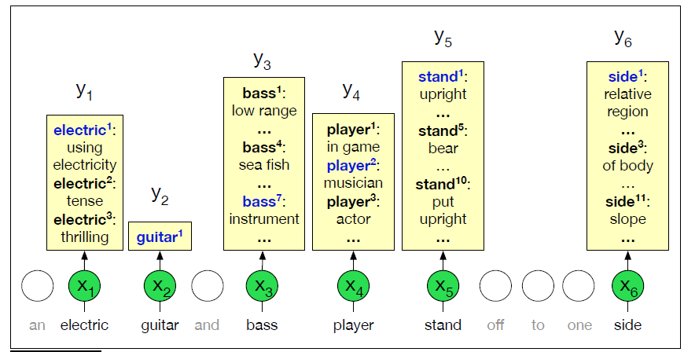
Supervised WSD - Sense Annotated Corpora
all-words WSD task, mapping from input words (x) to WordNet senses (y) (Jurafsky & Martin, 3rd ed., p.364)

Slide 65
Semantic Role Labelling (SRL)
Process of understanding who did what to whom, with what, where ...
NLP task of assigning labels to entities (expressed by words or phrases) indicating their semantic role in an event
For example: several entities with different semantic roles in this hitting event:
[Kristina AGT] hit [Scott EXP] with [a baseball INS] .
Where: AGENT (AGT), EXPERIENCER (EXP), INSTRUMENT (INS)
Note that semantic roles remain the same across different sentences:
[Kristina AGT] hit [Scott EXP] with [a baseball INS] .
[Scott EXP] was hit with [a baseball INS] by [Kristina AGT] .
[Scott EXP] was hit by [Kristina AGT] with [a baseball INS] .
After a slide by Yih and Toutanova

Slide 66
SRL Features
S
NP
VP
NP
Labeled Data
[AGENT The chancellor] announced new policy measures.
Feature Extraction
Predicate: announce
Voice (whether predicate is active or passive): active
Phrase Type (NP, PP, …) of classified constituent: NP
Minimal Path from classified constituent to predicate: NP↑S↓VP↓VBD
Position (before/after) of classified constituent with regard to predicate: before
Head Word of classified constituent: chancellor
Sub-categorization for parent of predicate: VP→VBD,NP
Feature Vector
AGENT: [announce, active, NP, NP ↑S↓VP↓VBD, before, chancellor, VP→VBD,NP]
DT
NN
VBD
DT
JJ
NN
NN
Jurafsky & Martin, 3rd ed., p.381-383

Slide 67
Coreference Resolution
“Barack Obama nominated Hillary Rodham Clinton as his secretary of state on Monday. He chose her because she had foreign affairs experience as a former First Lady.”
Step 1: Identify all mentions - coreference candidates
“Barack Obama nominated Hillary Rodham Clinton as his secretary of state on Monday. He chose her because she had foreign affairs experience as a former First Lady.”
Mention Detection
Step 2: Identify all mentions that refer to the same real world entity
“Barack Obama nominated Hillary Rodham Clinton as his secretary of state on Monday. He chose her because she had foreign affairs experience as a former First Lady.”
Mention Clustering
“Barack Obama nominated Hillary Rodham Clinton as his secretary of state on Monday. He chose her because she had foreign affairs experience as a former First Lady.”
Example and slide adapted from:https://courses.cs.washington.edu/courses/csep517/20wi/slides/csep517wi20-Coreference.pdf

Slide 68
Mention Clustering – Features
Recency - more recently mentioned entities are preferred
John went to a movie. Jack went as well. He was not busy. He = Jack (He ≠ John)
Syntactic agreement
Jack gave Mary a gift. She was excited. She = Mary (She ≠ Jack)
Other syntactic constraints
John bought him a new car. him ≠ John
Semantic compatibility
… the mining conglomerate … the company … company = conglomerate
Grammatical Role - prefer entities in the subject position
John went to a movie with Jack as he was not busy. He = John (He ≠ Jack)
Slide adapted from: https://www.cs.princeton.edu/courses/archive/fall19/cos484/lectures/lec21.pdf

Slide 69
Social Media Analysis

Slide 70


Social Media Analysis
This lecture is about opinion mining from social media
social media data: type of data
opinion mining: type of analysis
Images source: https://www.dreamstime.com

Slide 71
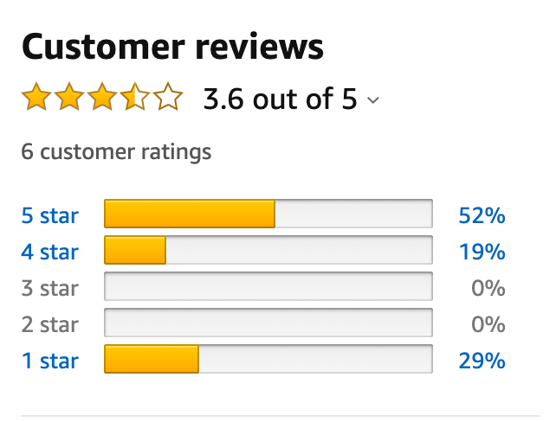



Opinionated Text - Some Examples
Reviews
Debate
Surveys
Analysis
Image sources: https://en.wikipedia.org/wiki/File:Debate_Logo.svg; https://blog.hubspot.com/service/customer-review-sites; https://depositphotos.com/329101118/free-stock-illustration-financial-analysis-business-performance-report.html; https://commons.wikimedia.org
Notes:
hotel, movie or other reviews (product ratings), political discourse and commenting (election polls), business and financial analysis (stock value prediction), ...

Slide 72
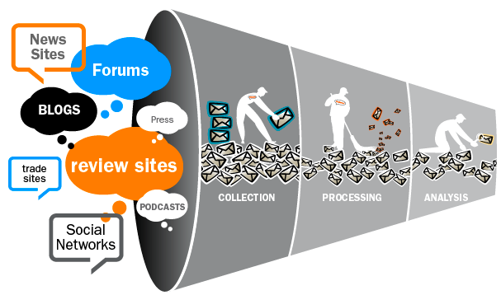
Social Media Analysis - Challenges
Reddit
Facebook
Twitter
Image source https://www.promptcloud.com/wp-content/uploads/2015/05/Social-Media-Monitoring.png

Slide 73

Sentiment Analysis – Task Definition
Sentiment analysis input data
Product reviews; Travel forums; Political discourse; Surveys; other!
Predict the sentiment expressed by input data
Binary Classification: predict positive or negative sentiment class
Ordinal Classification: predict a rate on a scale
Notes:
Remember? From Lec 1

Slide 74
Sentiment Analysis Approaches
‘Unsupervised’ - Lexicon-based Approaches
Lexicons – MPQA, LIWC, SentiWordNet
VADER
Supervised - Probabilistic Approaches
Machine Learning
E.g. SVM, Naïve Bayes
Supervised - Deep Learning Approaches
Neural Networks
E.g. BERT/BERTweet
Require Annotated Data
Notes:
TextBlob is a simple library which supports complex analysis and operations on textual data. For lexicon-based approaches, a sentiment is defined by its semantic orientation and the intensity of each word in the sentence. ... TextBlob returns polarity and subjectivity of a sentence.
VADER (Valence Aware Dictionary and sEntiment Reasoner) is a lexicon and rule-based sentiment analysis tool that is specifically attuned to sentiments expressed in social media, and works well on texts from other domains.

Slide 75
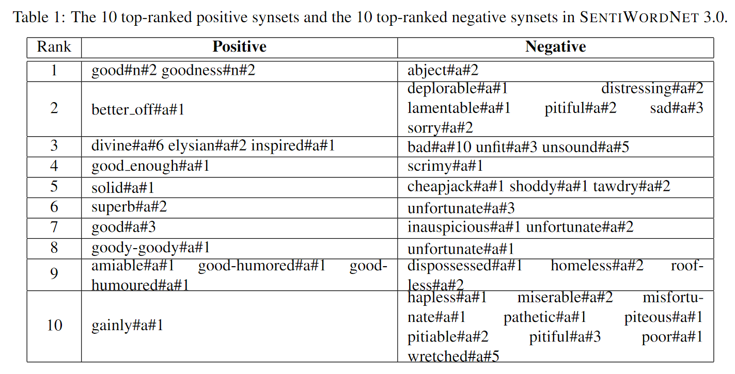
Sentiment Lexicon - SentiWordNet
Derived from WordNet, adding sentiment polarity on (words in) WordNet synsets
Baccianella, S., Esuli, A., & Sebastiani, F. (2010). Sentiwordnet 3.0: An enhanced lexical resource for sentiment analysis and opinion mining. In Proceedings of LREC.
Notes:
The table shows the simplest form of a sentiment lexicon, others include .. which can have a rating of valence
The results indicate SentiWordNet could be used as an important resource for sentiment classification tasks.

Slide 76
Sentiment Analysis - Features
Sentiment features (sentiment lexicon)
Linguistic features
N-grams
part-of-speech (N, V, Adj, …)
syntactic dependency (nsubj, dobj, amod, nmod, … )
modal verbs (could be, should be, …)
Social Media features (hashtags, emoticons, …)
Other features (negation)
Feature selection and weighting: occurrence (binary), freq, PMI, TF-IDF

Slide 77
Aspect-based Sentiment Analysis
Polarity: Rate the sentiment of the text as +ve or –ve
“The camera’s focus was bad, but has a great size and is easy-to-use.”
Aspect: Detect the sentiment aspect (‘target/topic of the sentiment’)
“The camera’s focus was bad, but has a great size and is easy-to-use.”

Slide 78
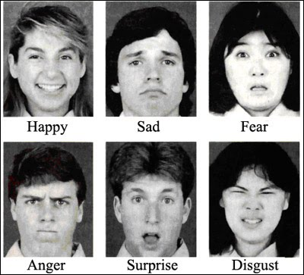
Emotion Models - Ekman
Most widely used model is Ekman’s with 6 basic facial emotions
Ekman, P. (1993). Facial expression and emotion. American Psychologist, 48(4), 384–392.

Slide 79
Ethics in NLP

Slide 80

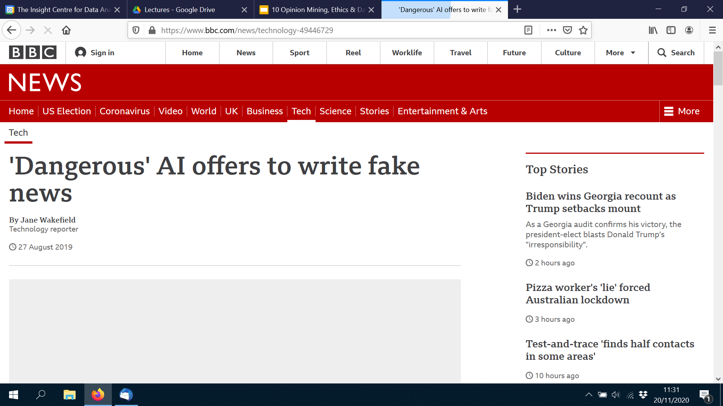

Bad NLP
‹#›

Slide 81
General Data Protection Regulation (GDPR)
“Regulation … 2016/679 of the European Parliament and of the Council ... regulates the processing by an individual, a company or an organisation of personal data relating to individuals in the EU.”
https://ec.europa.eu/info/law/law-topic/data-protection/reform/what-does-general-data-protection-regulation-gdpr-govern_en
‹#›

Slide 82
Personal Data
“Personal data is any information that relates to an identified or identifiable living individual.
Different pieces of information, which collected together can lead to the identification of a particular person, also constitute personal data.
Personal data that has been de-identified, encrypted or pseudonymised but can be used to re-identify a person remains personal data and falls within the scope of the GDPR.
Personal data that has been rendered anonymous in such a way that the individual is not or no longer identifiable is no longer considered personal data.
For data to be truly anonymised, the anonymisation must be irreversible.”
https://ec.europa.eu/info/law/law-topic/data-protection/reform/what-personal-data_en
‹#›

Slide 83
Data Protection Impact Assessment
Identify potential data privacy and data protection issues associated with the data collection for a specific (NLP) task by answering questions such as:
Have you identified the minimally sufficient amount of data for your purpose?
Have you informed affected individuals what you are doing with their data?
Have you identified a secondary use for personal data you collected?
Have you established the maximum time period required for keeping the data?
Have you developed appropriate data anonymization strategies?
Data Protection Impact Assessment is to be discussed with and approved by the Data Protection Officer at the Data Controller (organization where the task is done).
https://www.dataprotection.ie/en/organisations/know-your-obligations/data-protection-impact-assessments
‹#›

Slide 84
Trustworthy AI
ETHICS GUIDELINES FOR TRUSTWORTHY AI: High-Level Expert Group on Artificial Intelligence
“Trustworthy AI has three components …:
1. it should be lawful, complying with all applicable laws and regulations ;
2. it should be ethical, ensuring adherence to ethical principles and values; and
3. it should be robust, both from a technical and social perspective, since, even with good intentions, AI systems can cause unintentional harm.“
“In an AI context, equality entails that the system’s operations cannot generate unfairly biased outputs (e.g. the data used to train AI systems should be as inclusive as possible, representing different population groups).”
‹#›
https://www.aepd.es/sites/default/files/2019-12/ai-ethics-guidelines.pdf

Slide 85
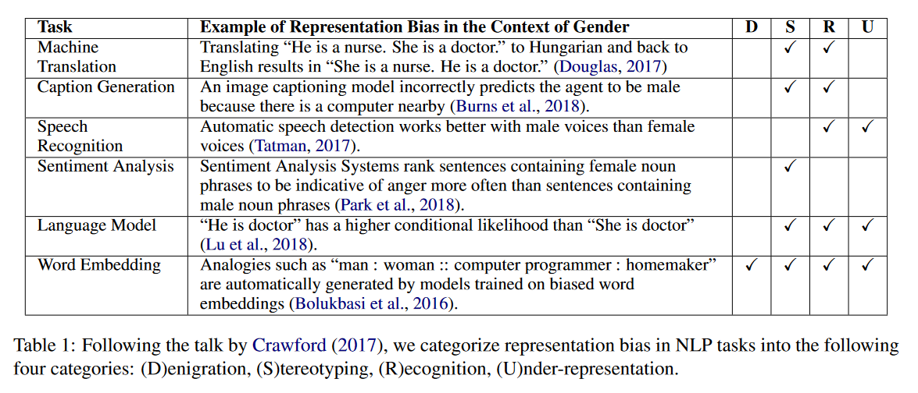
Bias in NLP
Sun, T., Gaut, A., Tang, S., Computational Linguistics (ACL 2019). Huang, Y., ElSherief, M., Zhao, J., Mirza D., Belding E., Chang K-W, & Wang, W. Y. (2019). Mitigating Gender Bias in Natural Language Processing: Literature Review. In Proceedings of the 57th ACL Conference (pp. 1630-1640).
‹#›

Slide 86
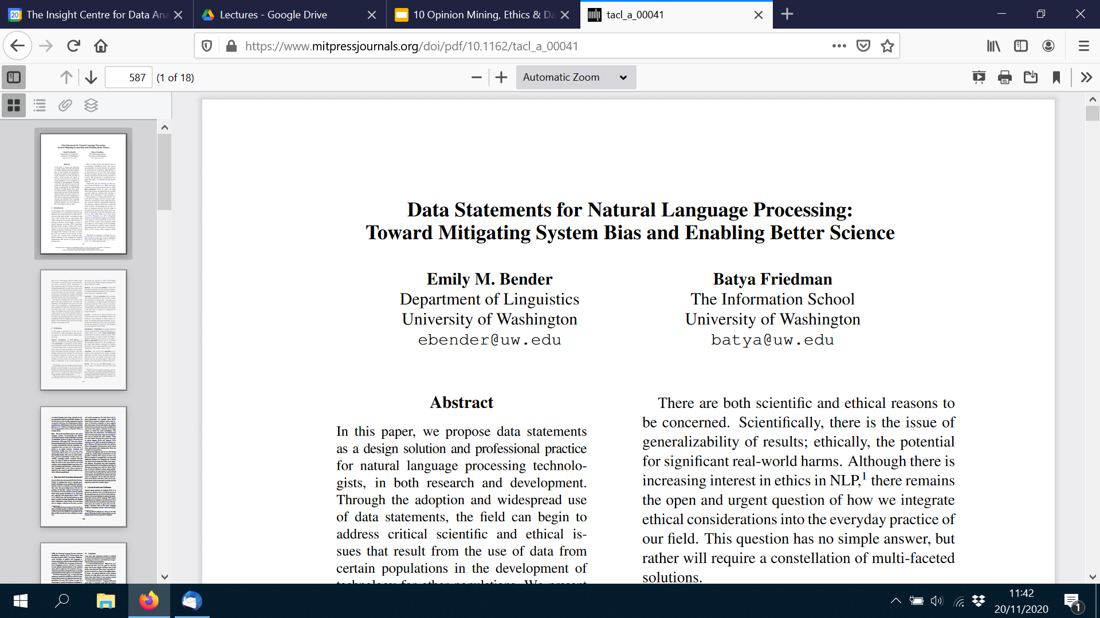
Data Statements
“A data statement is a characterization of a dataset that provides context to allow developers and users to better understand ... what biases might be reflected in systems built on the software.”
“We propose here that foregrounding the characteristics of our datasets can help, by allowing reasoning about what the likely effects may be and by making it clearer which populations are and are not represented, for both training and test data.”
Bender, E. M., & Friedman, B. (2018). Data statements for natural language processing: Toward mitigating system bias and enabling better science. Transactions of the Association for Computational Linguistics, 6, 587-604.
‹#›

Slide 87
Good luck with the exam!

